Slide 1


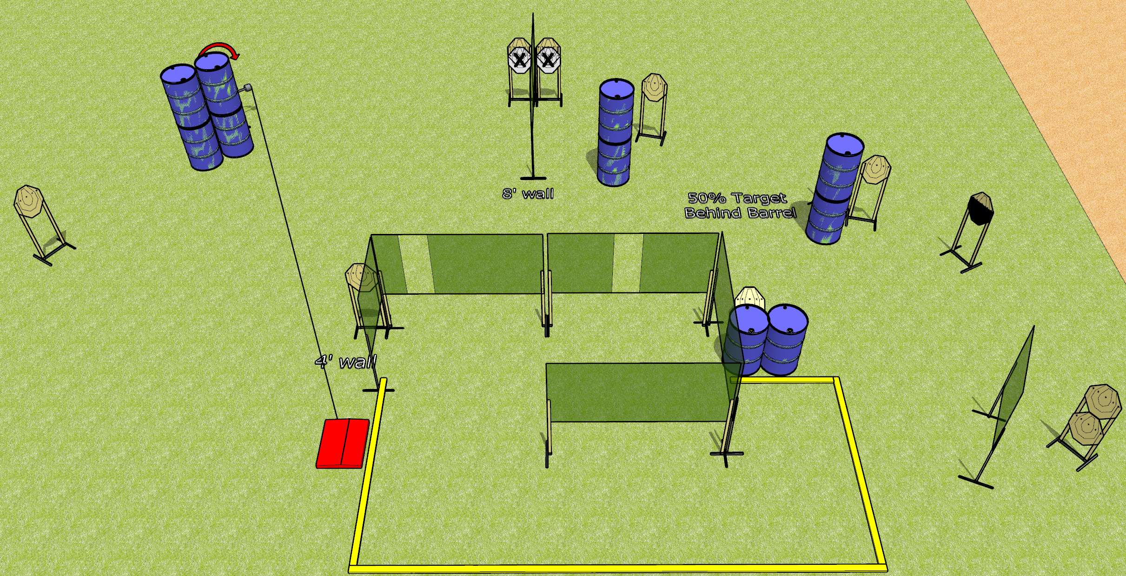
 | Dothan Gun Club – USPSA Match Hook Course Designer : Drew Coleman
Round Count 24 rounds 12 paper
Equipment List 10 wall feet 1 medium fault line Stomp box + swinger

Slide 2
Hook
Written Stage Briefing
Hook is a 24 round, 120 point, Comstock course of fire. There are 12 IPSC targets. The best 2 hits on paper will score. The start signal is audible.
The swinger is activated by the stomp box, and remains visible at rest.
Handgun start position is inside the shooting area, wrists below belt. Handgun is loaded and holstered.
PCC start position is inside the shooting area, stock on belt. Loaded carbine is held with both hands, safety on.
On start signal, engage targets as they become available from within the shooting area.

